Slide 1

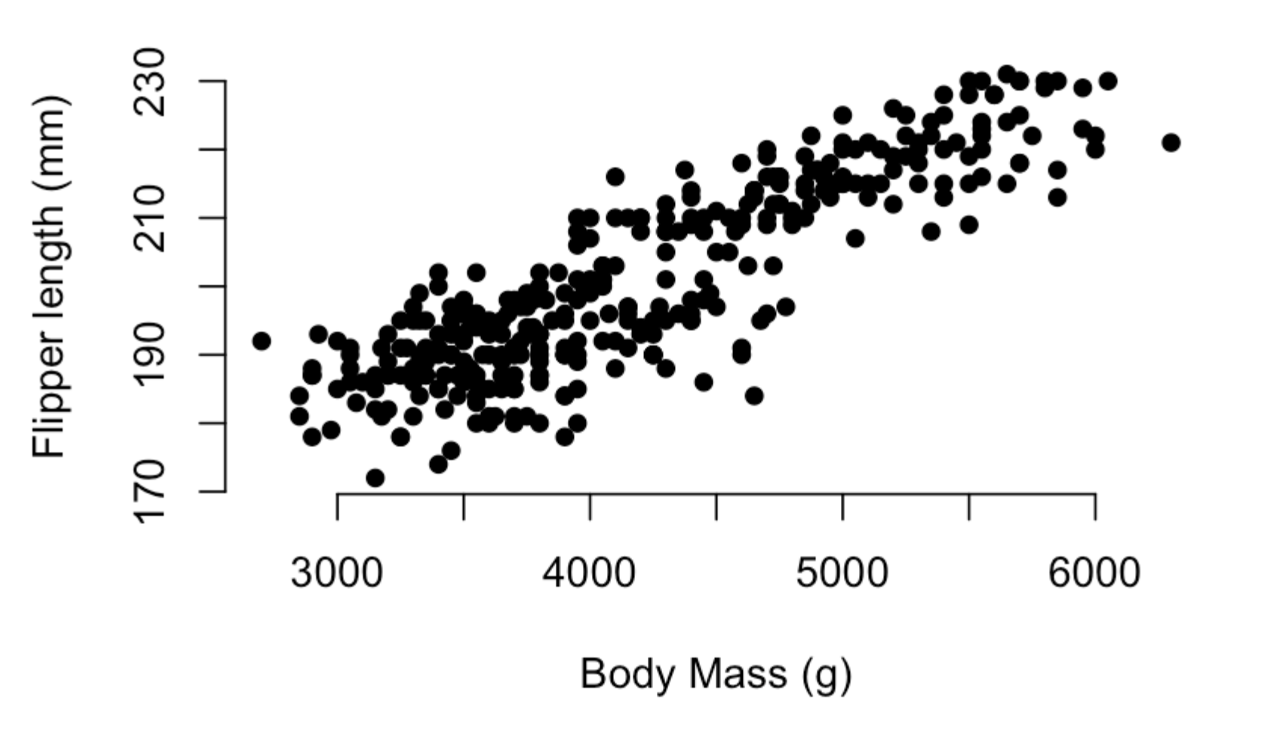
Stats lecture 6
Linear models

Slide 2
Correlations
When we have two continuous variables we often want to know how they relate.
For example, we might want to know how flipper size changes with body size in penguins.
The first thing we do is decide on our model, that is what affects what. Here we will say that body size (explanatory) drives flipper size (response)

Slide 3
Co-variance
In our scatter plot we can visually look at how changes in the explanatory variable (body mass) causes changes in our response variable (Flipper length).
We can see here as we increase body mass flipper length increases.
But can we say this with more confidence.

Slide 4
Co-variance
In our scatter plot we can visually look at how changes in the explanatory variable (body mass) causes changes in our response variable (Flipper length).
We can see here as we increase body mass flipper length increases.
But can we say this with more confidence.
Explanatory variable is the variable we think affects the response variable

Slide 5
Co-variance
In our scatter plot we can visually look at how changes in the explanatory variable (body mass) causes changes in our response variable (Flipper length).
We can see here as we increase body mass flipper length increases.
But can we say this with more confidence.
Response variable is the variable we think responds to changes in the explanatory variable
Explanatory variable is the variable we think affects the response variable

Slide 6
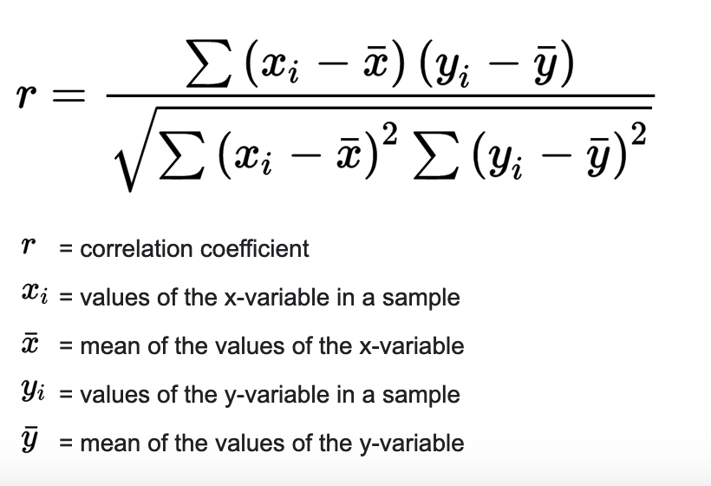
Co-variance
Pearson's correlations give a coefficient indicating how tow variables x and y relate to each other.
Coefficient of correlation is between -1 and 1, with -1 indicating a perfect negative correlation and 1 a perfect positive correlation.

Slide 7
Co-variance
Pearson's correlations give a coefficient indicating how tow variables x and y relate to each other.
Coefficient of correlation is between -1 and 1, with -1 indicating a perfect negative correlation and 1 a perfect positive correlation.
This measures how much variance is explained by covariance

Slide 8
Co-variance
Pearson's correlations give a coefficient indicating how tow variables x and y relate to each other.
Coefficient of correlation is between -1 and 1, with -1 indicating a perfect negative correlation and 1 a perfect positive correlation.
This measures how much variance there is overall

Slide 9
Co-variance
Pearson's correlations give a coefficient indicating how tow variables x and y relate to each other.
Coefficient of correlation is between -1 and 1, with -1 indicating a perfect negative correlation and 1 a perfect positive correlation.
This measures how much variance is explained by covariance
This measures how much variance there is overall

Slide 10
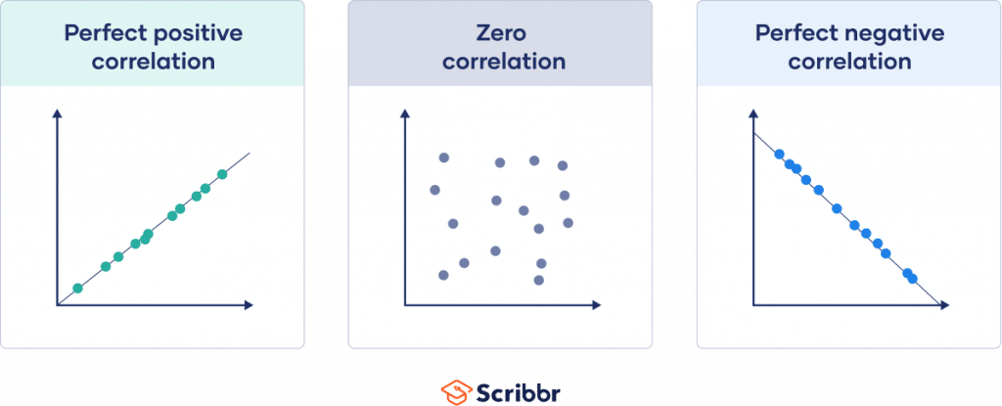
Pearson’s correlation
Pearson's correlations give a coefficient indicating how tow variables x and y relate to each other.
Coefficient of correlation is between -1 and 1, with -1 indicating a perfect negative correlation and 1 a perfect positive correlation.
R = 0

Slide 11
Pearson’s correlation
Pearson's correlations give a coefficient indicating how tow variables x and y relate to each other.
Coefficient of correlation is between -1 and 1, with -1 indicating a perfect negative correlation and 1 a perfect positive correlation.
R = 1

Slide 12
Pearson’s correlation
Pearson's correlations give a coefficient indicating how tow variables x and y relate to each other.
Coefficient of correlation is between -1 and 1, with -1 indicating a perfect negative correlation and 1 a perfect positive correlation.
R = -1

Slide 13
Pearson’s correlation
Pearson's correlations give a coefficient indicating how tow variables x and y relate to each other.
Coefficient of correlation is between -1 and 1, with -1 indicating a perfect negative correlation and 1 a perfect positive correlation.
R = -1
R = 0
R = 1

Slide 14
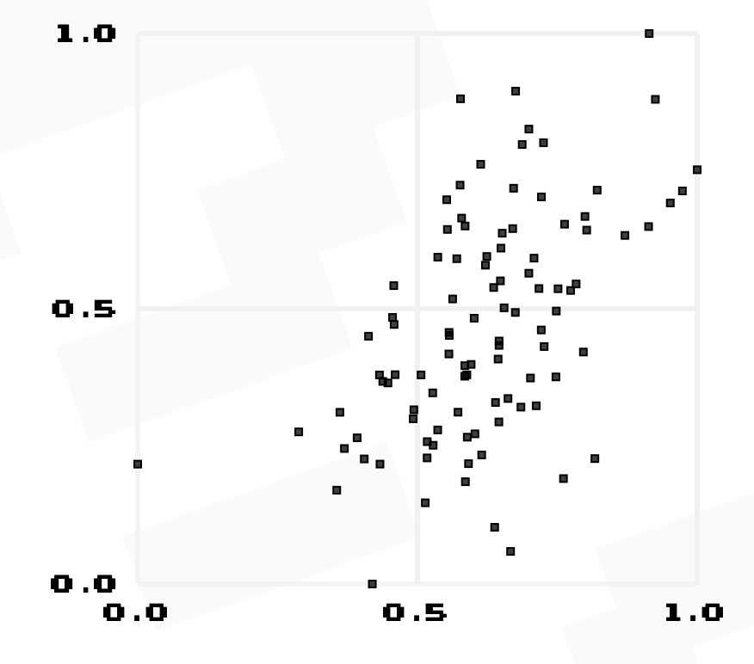
https://www.guessthecorrelation.com/

Slide 15
https://www.guessthecorrelation.com/
correlation = 0.53

Slide 16
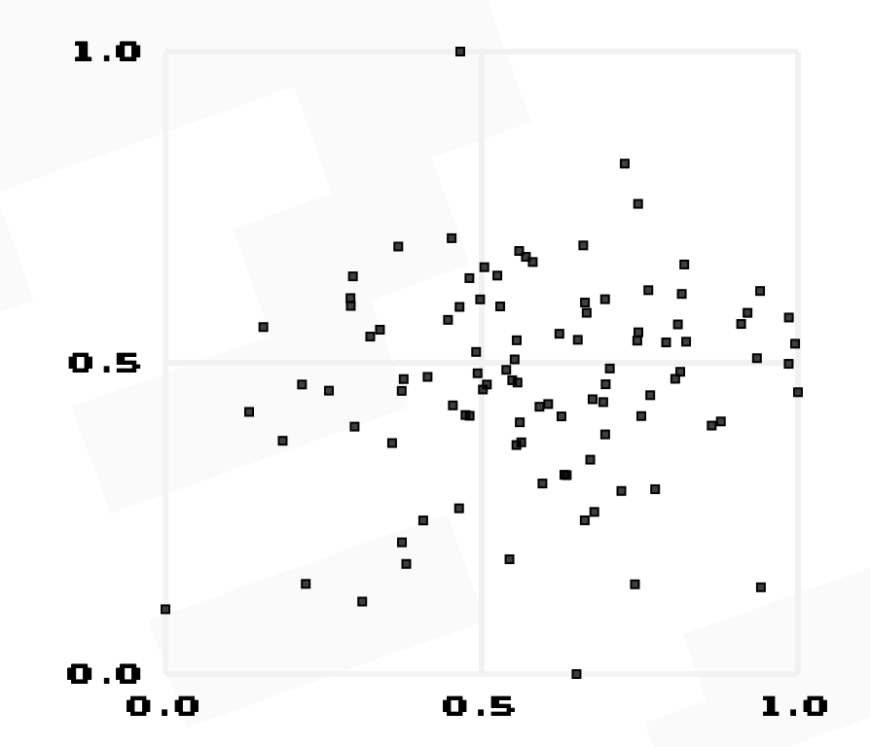
https://www.guessthecorrelation.com/

Slide 17
https://www.guessthecorrelation.com/
correlation = 0.13

Slide 18
R-squared
We can also ask how close the data is to these correlations with what is called the R-squared value.
High R-squared values indicate that most of the variance in the response variable is explained by the explanatory variable.
R-squared is between 0 and 1 and is simply calculated as the square of the coefficient of correlation

Slide 19
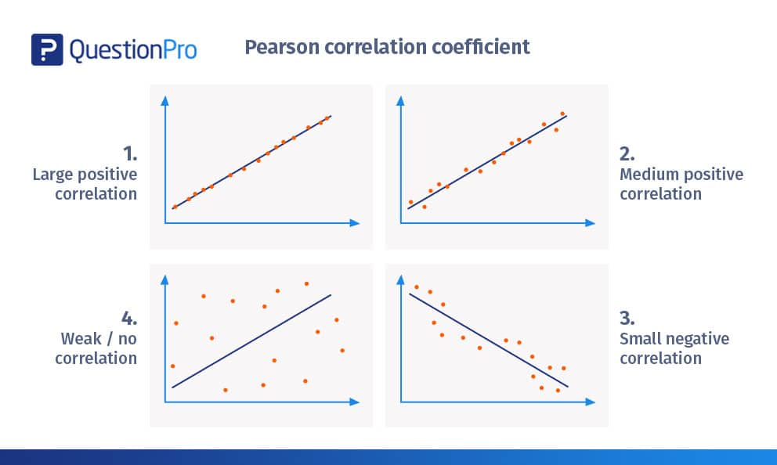
R-squared
We can also ask how close the data is to these correlations with what is called the R-squared value.
High R-squared values indicate that most of the variance in the response variable is explained by the explanatory variable.
R-squared is between 0 and 1 and is simply calculated as the square of the coefficient of correlation
R-squared close to 1

Slide 20
R-squared
We can also ask how close the data is to these correlations with what is called the R-squared value.
High R-squared values indicate that most of the variance in the response variable is explained by the explanatory variable.
R-squared is between 0 and 1 and is simply calculated as the square of the coefficient of correlation
R-squared close to 1
R-squared closer to zero

Slide 21
https://www.guessthecorrelation.com/
We can also ask how close the data is to these correlations with what is called the R-squared value.
High R-squared values indicate that most of the variance in the response variable is explained by the explanatory variable.
R-squared is between 0 and 1 and is simply calculated as the square of the coefficient of correlation
R-squared close to 1
R-squared closer to zero

Slide 22
Calculate the coefficient of correlation and R squared for penguins flippers
Upload the penguin dataset
pen_data <- read.csv("penguin_1_10_2023.csv")
Use the function
cor(x, y)
to calculate the coefficient of correlation.
Calculate r-squared by using
c(cor(x, y))^2

Slide 23
Calculate the coefficient of correlation and R squared for penguins flippers
Upload the penguin dataset
pen_data <- read.csv("penguin_1_10_2023.csv")
Use the function
cor(x, y) = 0.87
to calculate the coefficient of correlation.
Calculate r-squared by using
c(cor(x, y))^2 = 0.76

Slide 24
Linear Models
A model is just a simplified version of the world

Slide 25
Linear Models
A model is just a simplified version of the world
We can use simple lines to model the world

Slide 26
Linear Models
A model is just a simplified version of the world
We can use simple lines to model the world
This line is a model trying to explain how body size drives flipper length
With this model if I have the body size of a penguin I have a prediction of its flipper length

Slide 27
Linear Models
Lines can be expressed as
y = Mx + c

Slide 28
Linear Models
Lines can be expressed as
y = Mx + c
Response variable
The y-axis values
for the data

Slide 29
Linear Models
Lines can be expressed as
y = Mx + c
The Slope of the
Line. A coefficient with 1 value

Slide 30
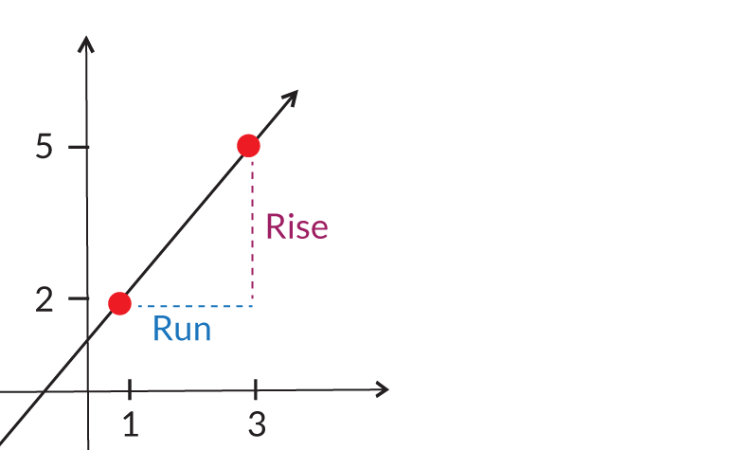
Linear Models
Here the Run is 2 and the Rise is 3 so the slope is 3/2 = 1.5.
This means for every 1 unit we increase on the x-axis we increase by 1.5 on the y-axis.
The slope says how much we change on the y-axis when we change the x-axis by 1 unit.

Slide 31
Linear Models
Lines can be expressed as
y = Mx + c
Explanatory variable
The x-axis values
for the data

Slide 32
Linear Models
Lines can be expressed as
y = Mx + c
The intercept of the
Line. A coefficient with 1 value

Slide 33
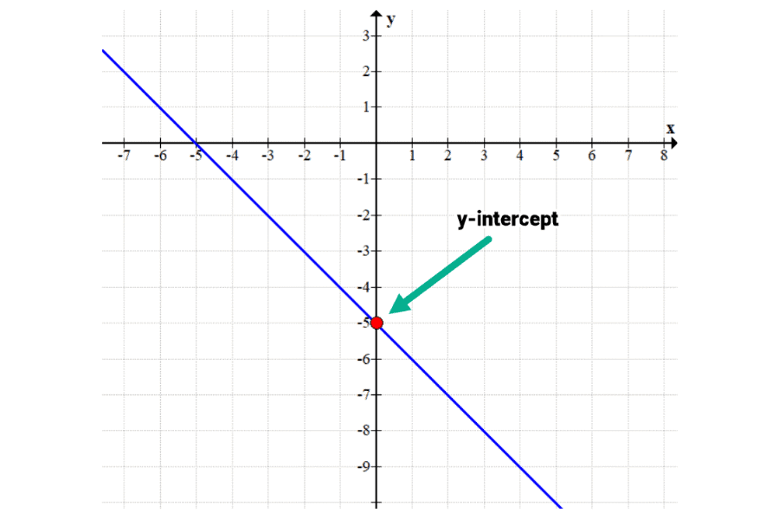
Linear Models
Lines can be expressed as
y = M(0) + c
y = c
When x is zero the line crosses the y-axis. This is the intercept and the value of c

Slide 34
Linear Models
Lines can be expressed as
y = Mx + c
Response variable
The y-axis values
for the data
The Slope of the
Line. A coefficient with 1 value
Explanatory variable
The x-axis values
for the data
The intercept of the
Line. A coefficient with 1 value

Slide 35
Linear Models
We can use the formula y = Mx + c to draw a line through the data which will then give us a model of how we expend y to change with x.

Slide 36
Linear Models
We can use the formula y = Mx + c to draw a line through the data which will then give us a model of how we expend y to change with x.
Example
Imagine we drew a line with an intercept of 160 and a slope of 0.01 we can write it as
Y = 0.01X + 160

Slide 37
Linear Models
We can use the formula y = Mx + c to draw a line through the data which will then give us a model of how we expend y to change with x.
Example
Imagine we drew a line with an intercept of 160 and a slope of 0.01 we can write it as
Y = 0.01X + 160
If I found a penguin of mass 4000g I can predict its flipper length to be
Y = 0.01(4000) + 160

Slide 38
Linear Models
We can use the formula y = Mx + c to draw a line through the data which will then give us a model of how we expend y to change with x.
Example
Imagine we drew a line with an intercept of 160 and a slope of 0.01 we can write it as
Y = 0.01X + 160
If I found a penguin of mass 4000g I can predict its flipper length to be
Y = 0.01(4000) + 160
Y = 200

Slide 39
Linear Models
We can use the formula y = Mx + c to draw a line through the data which will then give us a model of how we expend y to change with x.
Example
Imagine we drew a line with an intercept of 160 and a slope of 0.01 we can write it as
Y = 0.01X + 160
If I found a penguin of mass 4000g I can predict its flipper length to be
Y = 0.01(4000) + 160
Y = 200

Slide 40
Linear Models
But how do find this line?
Example
Imagine we drew a line with an intercept of 160 and a slope of 0.01 we can write it as
Y = 0.01X + 160
If I found a penguin of mass 4000g I can predict its flipper length to be
Y = 0.01(4000) + 160
Y = 200

Slide 41
Linear Models
But how do find this line?

Slide 42
Linear Models
We naturally know that A is closest to the data but we need a way to do this in a quantified way.
A
B
C

Slide 43
Linear Models
Residuals and model fit
A
We calculate the residuals of every point to the fitted line.
And get the sum of the squares of these residuals.

Slide 44
Linear Models
line with maximum likelihood = lowest Least squares value
A
The square of the sum of the residuals for the orange line is much larger compared to the green line.

Slide 45
Lets run a linear model in R
Upload the penguin dataset
pen_data <- read.csv("penguin_1_10_2023.csv")
Use the function
mod_1 <- lm(y ~ x)
summary(mod_1)

Slide 46
Lets run a linear model in R
Upload the penguin dataset
pen_data <- read.csv("penguin_1_10_2023.csv")
Run a linear model between flipper length and body mass
mod_1 <- lm(y ~ x)
summary(mod_1)

Slide 47
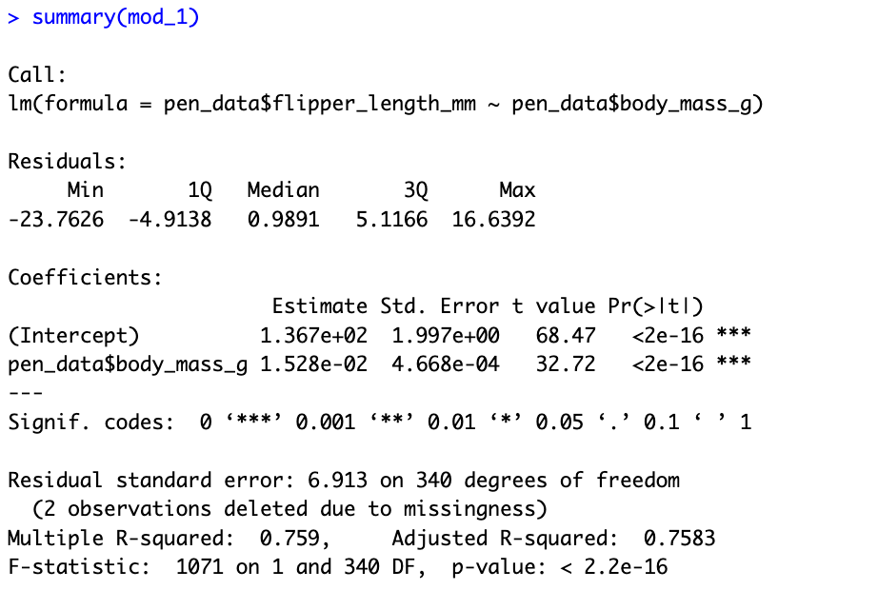
Lets run a linear model in R
The model you just ran

Slide 48
Lets run a linear model in R
Summary statistics of the residuals

Slide 49
Lets run a linear model in R
Model estimates of parameters and their significance

Slide 50
Lets run a linear model in R
Overall model statistics, including the R-squared and degrees of freedom.

Slide 51
Lets run a linear model in R
The model you just ran
Summary statistics of the residuals
Model estimates of parameters and their significance
Overall model statistics, including the R-squared and degrees of freedom.

Slide 52
Lets run a linear model in R
This is the estimated value of the intercept of the fitted line.

Slide 53
Lets run a linear model in R
This is the estimated value of the slope of the fitted line

Slide 54
Lets run a linear model in R
This is the estimated value of the intercept of the fitted line.
This is the estimated value of the slope of the fitted line

Slide 55
Plot linear model in R
plot(y ~ x)
abline(136.7, 0.015)

Slide 56
Plot linear model in R
Is this relationship just by chance?
Can I reject the Null?
The default Null in a linear model is a line with an intercept of zero and a slope of zero

Slide 57
Lets run a linear model in R
The standard error tells us how much uncertainty there is with our estimated values

Slide 58
Lets run a linear model in R
Each of these estimates are compared to their Null values (zero here).
Based on the uncertainty and how far these values are from the Null we can calculate a t-value which is used to calculated a p-value

Slide 59
Plot linear model in R
The p-value for both the intercept and the slope is significantly different to zero so we can say they are significant values.

Slide 60
Plot linear model in R
Remember, what is the biological relevancy of these values.
Biologically does it matter if the intercept value here was not significant?

Slide 61
Plot linear model in R
Remember, what is the biological relevancy of these values.
Biologically does it matter if the intercept value here was not significant?
Answer, no the intercept here has little biological relevance, the slope however tells us that for every gram increase we expected flipper size to increase by 0.015mm. Or we expect flipper size to increase by 45cm over the approximate 3000g range of our data.

Slide 62
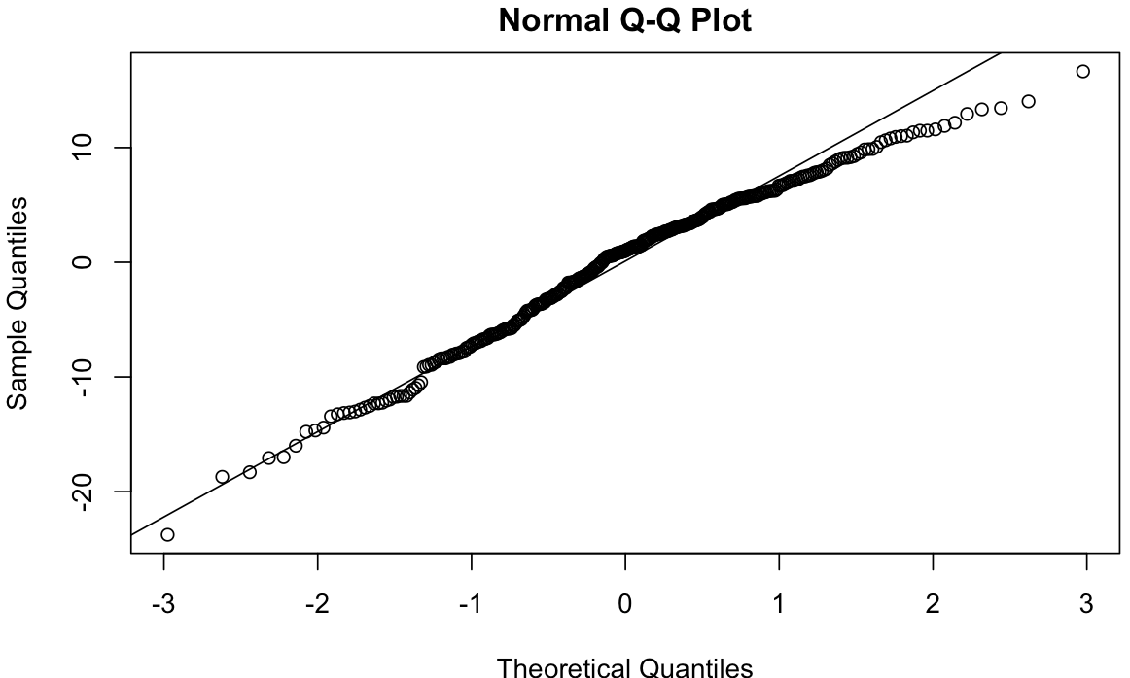
Linear model Assumptions
We can check our data by just plotting them
Its subjective but a great way at spotting funky looking distributions.
Linear models assumes that the residuals are normally distributed.
We can use QQ-plot like before

Slide 63
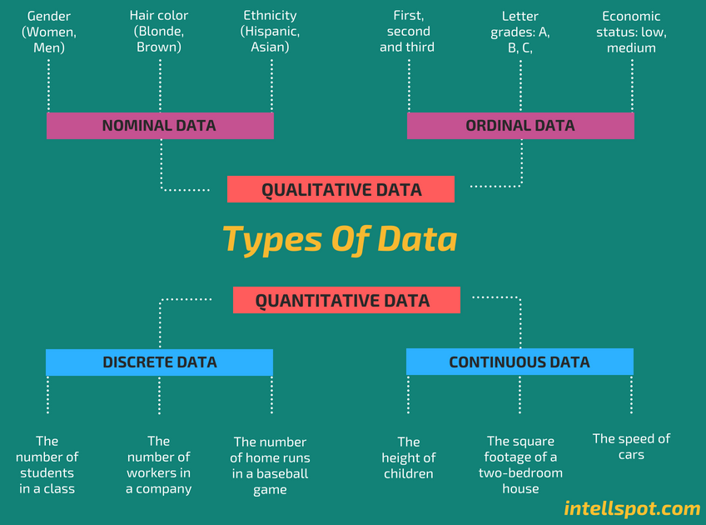
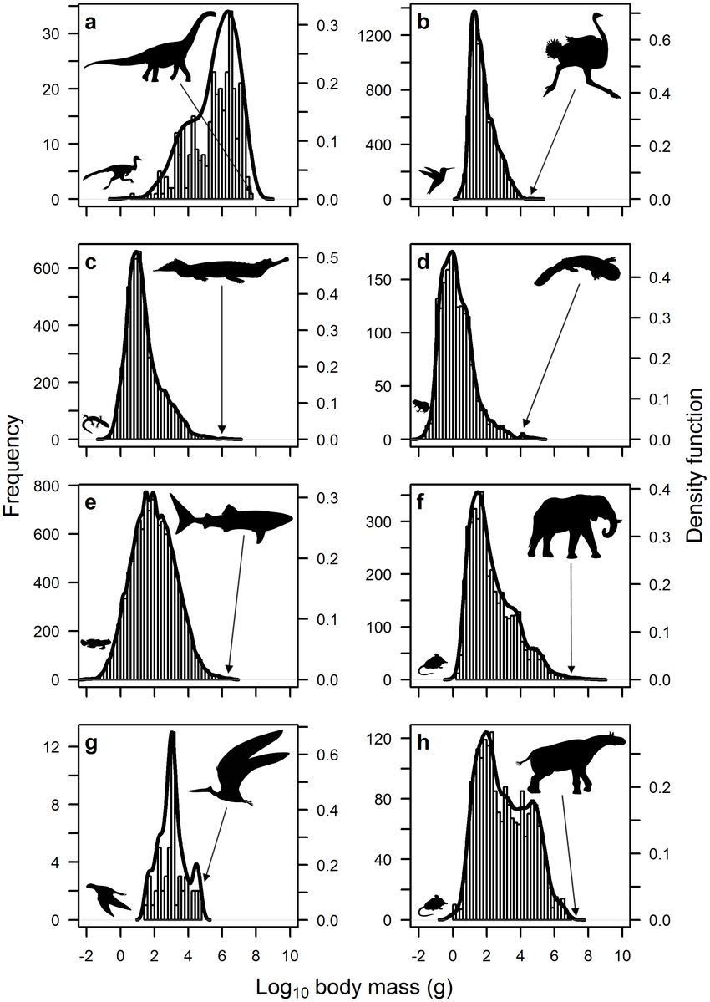
What to do if your data and residuals are not normal
Log -Normal
Log-Normal distribution
Positively skewed
A distribution that when log transformed becomes normal.
Very common in biology especial when scales are very large such as with body size across species.
Most animals are small leading to a log normal distribution

Slide 64
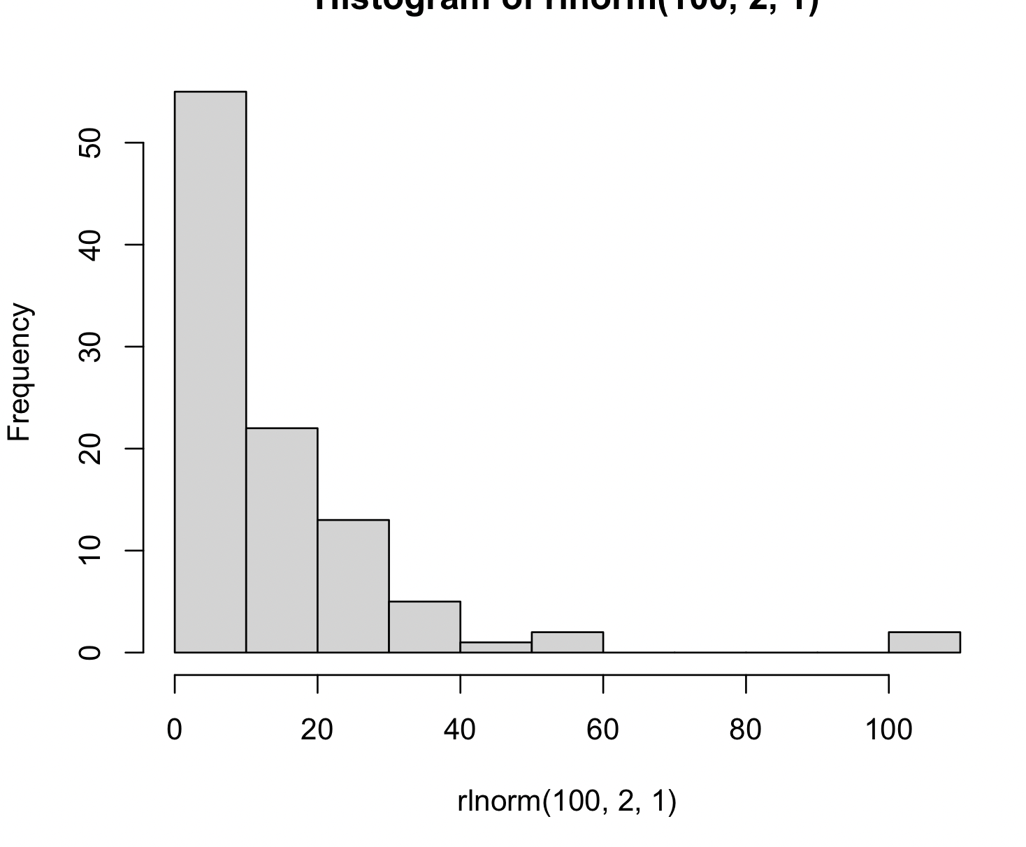
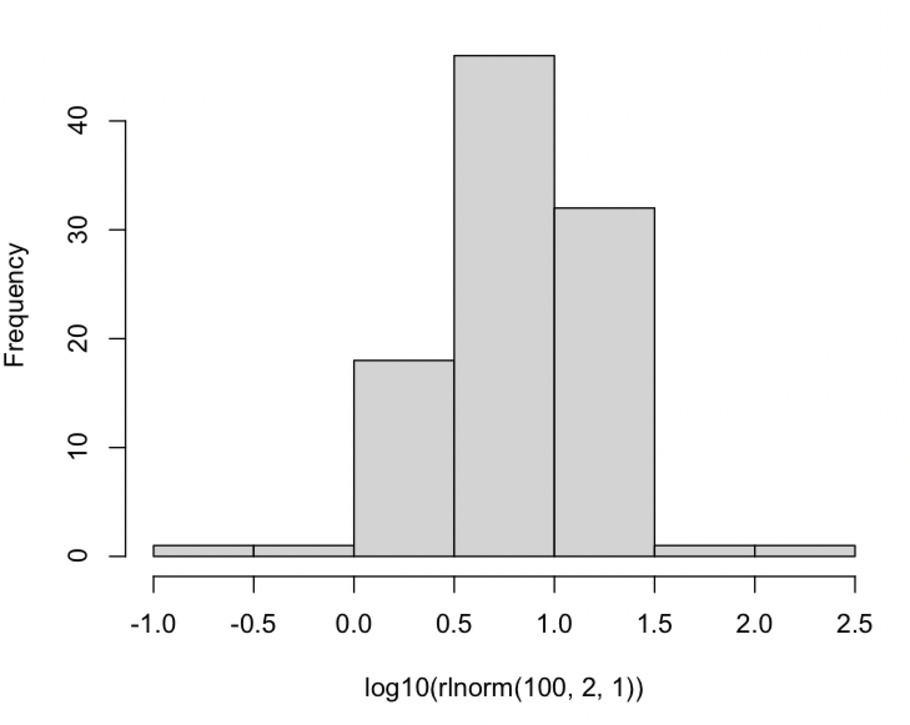
What to do if your data and residuals are not normal
Transformations
lnorm_data <- rlnorm(100, 2, 1))
hist(lnorm_data)
Logging a log-normal distribution will make the data more normal.
In the example on the right both histograms are for the same data but the log transformed data is clearly more normally distributed.
hist(log10(lnorm_data))

Slide 65
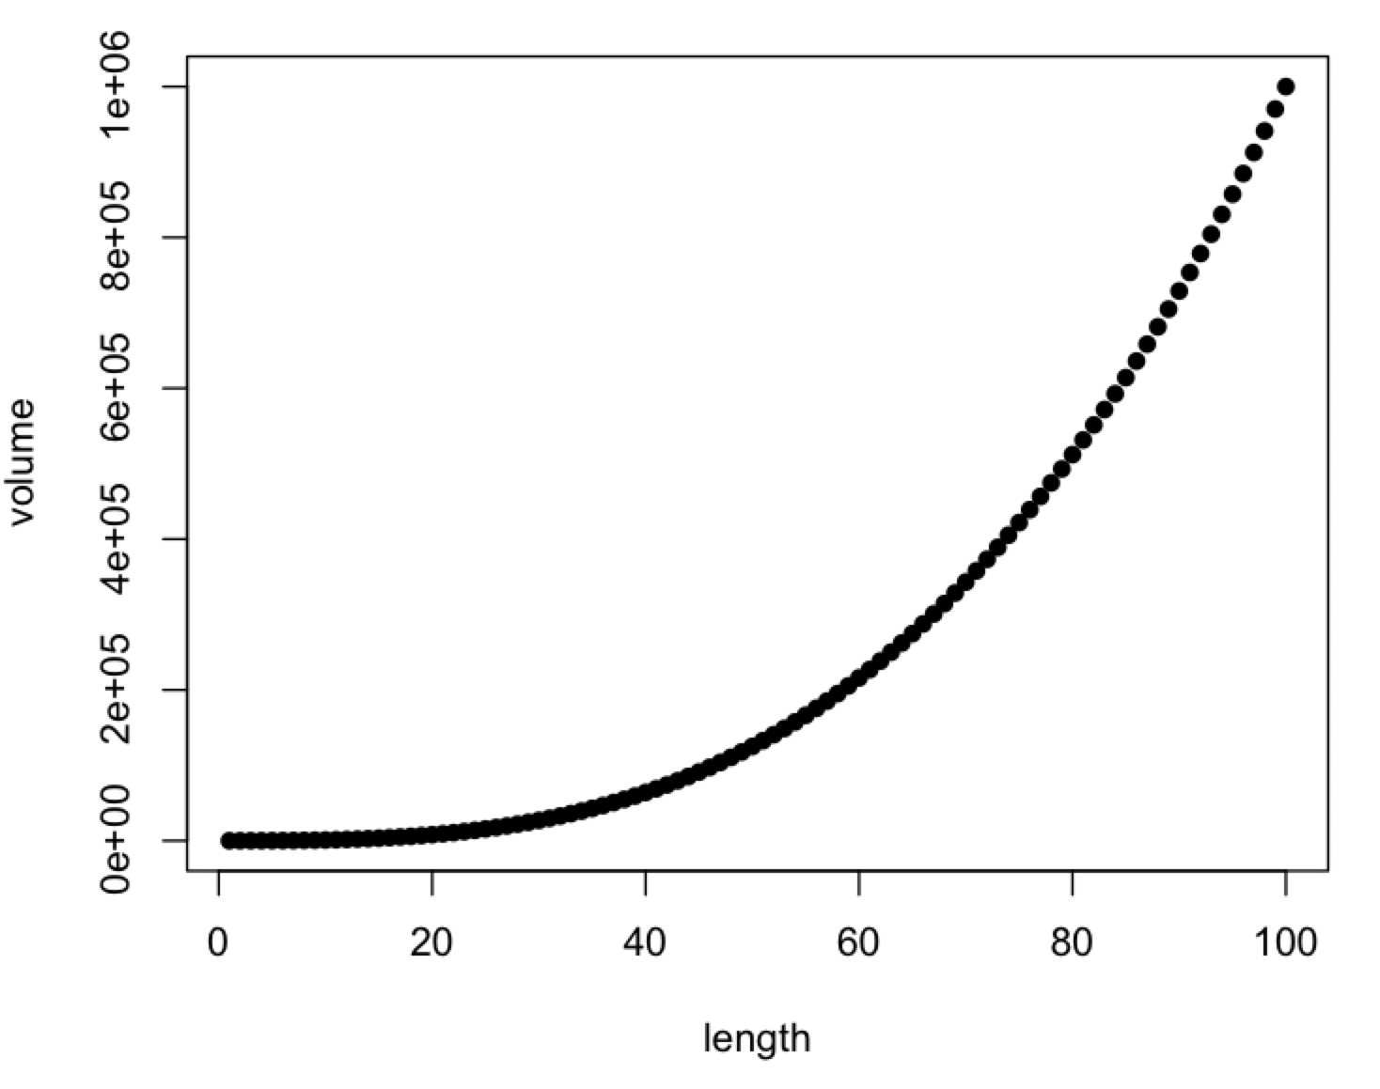
What to do if your data and residuals are not normal
Power laws
Many biological relationships follow the form of
y = X^{b}
An example is how volume increases with length in a box as
volume = length³

Slide 66
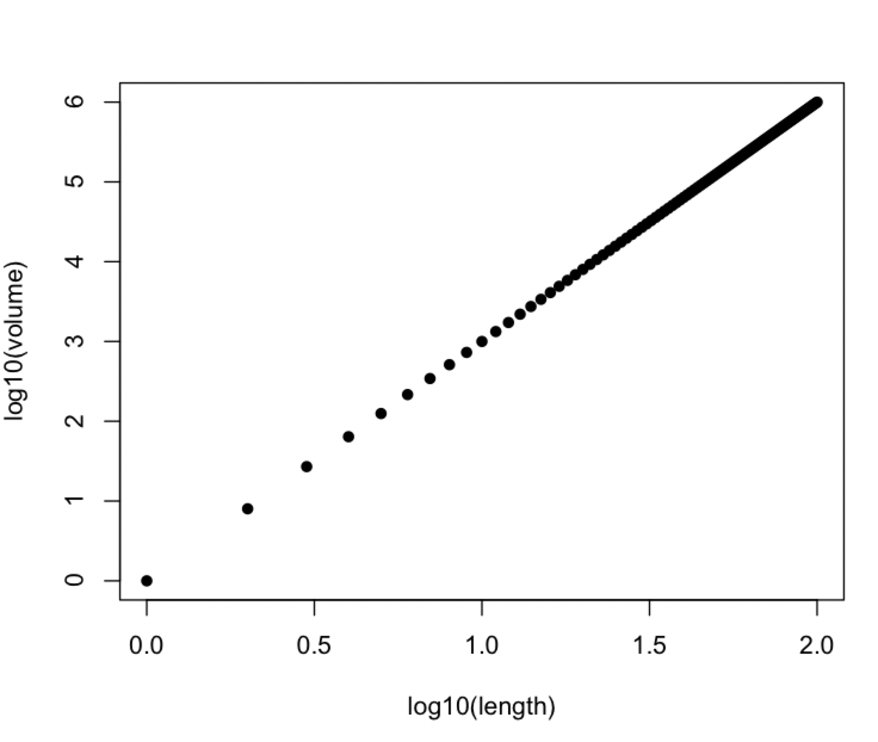
What to do if your data and residuals are not normal
Power laws
We can log power laws to make them a straight line making it easier to using linear models.
By logging we change the formula as
y = X^{b}
Log(y) = log(X)^{b}
Log(y) = b log(X)
In this new form b is now the slope of the log transformed line

Slide 67
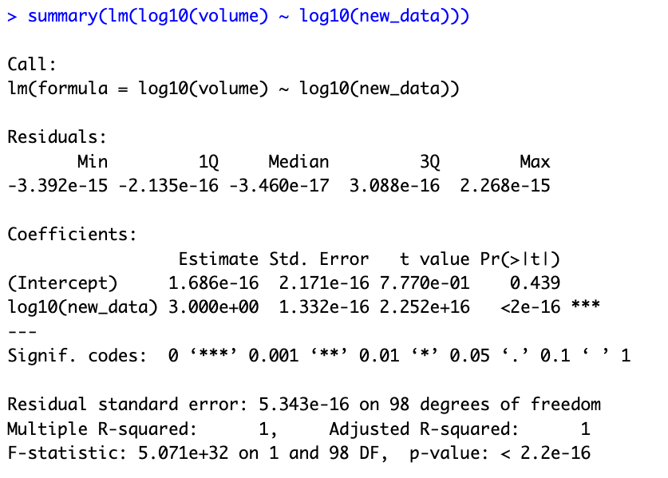
What to do if your data and residuals are not normal
Power laws
In our logged volume length example a linear model has a slope of 3 which was the power of the original relationship.
volume = length³
Log(volume) = log(length)³
Log(volume) = 3 log(length)

Slide 68
Summary
Linear models can be used to test the relationship between continuous variables
The coefficient of correlation give the direction and strength of a correlation
R-squared gives a indication of how well fit the model is
Linear models pick the line closest to the data based on the residuals.
The intercept and slope define the fitted line and can be Null tested
Linear models require normally distributed residuals
Log transformation can make some data normal and help with power law relationships.

